Slide 1

American Families
Professor Meyer

Slide 2
Culture: Shared set of values
Examples of Chinese values
  Respect for parents
  Respect for elders
  Respect for authority
  Nationalism: love of country
  Importance of guanxi
What do you think are American values?

Slide 3
What is individualism?

Slide 4
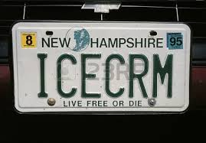
Examples of Individualism
The Orange Julius story
Vanity plates
Individualist perception of collectivists
Individual freedom: positive or self centered?
Do not respect their parents as much
Paying rent
Self help books
Alone time

Slide 5

Ideal American individualist
Bill Gates or Steve Jobs
Overcome adversity
Individualistic social skills
Accomplishments

Slide 6
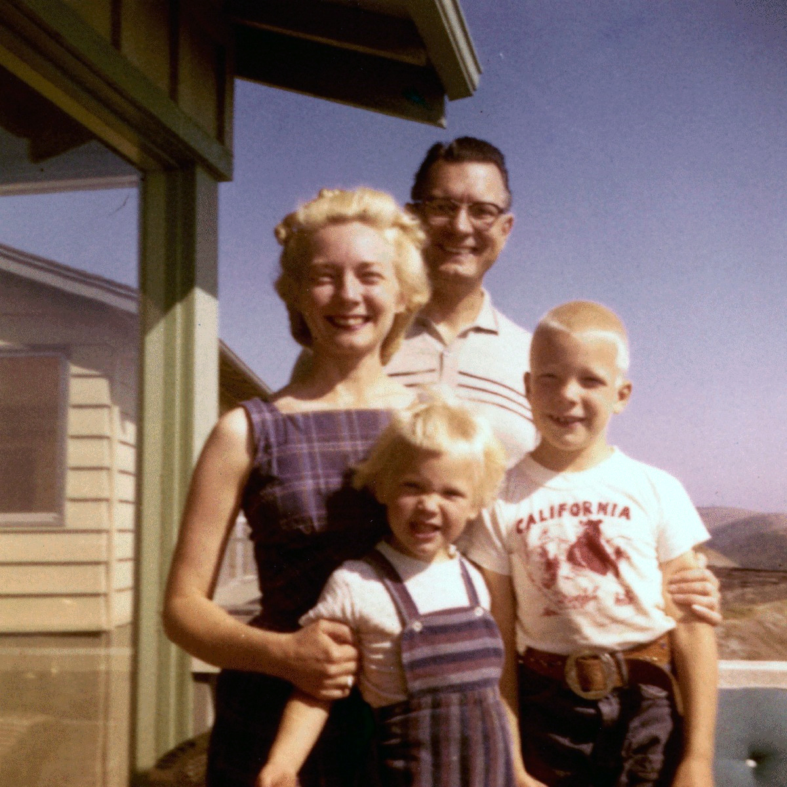
The American Nuclear Family
Notes:
nuclear family
relatives.
for most Americans, the family has tradi- tionally been a small group of people, not an extended network.

Slide 7

Alternative American Families
Notes:
Househusbands” or “stay-at- home dads”
“blended families”
“alternative families,”
Since international adoptions began in China, our adoptions unit has issued over 70,000 immigrant visas to Chinese orphans adopted by American citizens.
星期一

Slide 8
Interesting Statistics
Average American family has decreased from 3.2 to 2.5
Single-parent families are more common
41% of children are born out of wedlock
Average age to marry is 28 for men; 26 for women
Educated couples are more likely to deliberately have children
Notes:
Families are becoming smaller. The average American household in 2009 included about 2.5 people, down from about 3.2 as recently as 1985.
41 percent of children were born to unmarried women.
he average age at which men married was 28, up from 27 in 2005. For women the age was 26.2, higher than ever. According to the Center for Disease Control and Prevention, the 2009 marriage rate was 7.1 per 1,000 people, the lowest since 1932. The divorce rate in 2009 was 3.5 per 1,000 people, down from 4.7 in 1980.
National averages such as those quoted here mask significant differ- ences among regions and religious groups.

Slide 9

Why are families changing?
Women’s movement
Difficult economy
Diminishing stigma
Notes:
Following on the “women’s movement,” women began entering careers outside the traditional areas of teaching, nursing, and being a secretary.
More and more women are going to college, so much so that women now earn more doctoral degrees than men. In the process women are preparing themselves for financial independence from any future hus- band and delaying marriage and childbirth.
Difficult economic times have often required both parents to earn enough income to support a family, and have compelled many young people to remain in their parents’ home beyond age 18 or to return to it after leaving.
The stigma attached to divorce, cohabitation (that is, unmarried couples living together), and homosexuality has diminished but not vanished.

Slide 10
Individualism in Parenting
Children’s opinions have strong influence
“Well rounded” children
  Too much homework
Babysitters
Positive guidance instead of punishment
Children have their own room
Mind your own business
Notes:
strollers
lbeaskedfor their opinions and will express opinions even without being asked.
Children of any age may interrupt their parents, argue with them,
make demands of them, or loudly express their disapproval of parental
decisions they dislike.
larger than necessary. cribs
,childrenhavetheirownbedrooms,
share responsibility for—childcare, cooking, washing clothes, or doing other household chores.
Electricappliancesandelectronicentertainmentdevices(
ental care (straight teeth seem extremely important); medical care for any perceived defect; a preschool (where in some cases very young children are encouraged to learn to read); lessons for learning to draw, play a sport, dance, sing, or play a musical instrument; and perhaps counseling to help overcome emotional difficulties.
Academic achievement gets less emphasis from the average American family than it does from families in many other, particularly Asian, countries. American parents will complain if their children are given “too much homework”
Americans generally believe that parents “need some time away from the children” and often arrange for someone to babysit so they themselves can go out.
Many experts emphasize “positive guidance,” which means giving the child positive reinforcement when she behaves in a way that the parents like rather than punishing her when she does something the parents

Slide 11

Rebellious Teenager

Slide 12

Working Teenager

Slide 13

Peer Pressure

Slide 14

Empty-Nest Syndrome

Slide 15

Mid-Life Crisis

Slide 16

Senior Citizens, Snowbirds, and Nursing Homes

Slide 17



Christianity (Christians)
Protestantism (Protestants)
Catholicism (Catholic)
The Bible: Jesus Christ is the son of God

Slide 18





Slide 19


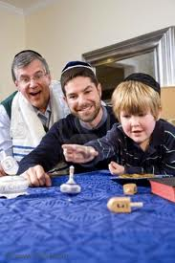

Judaism (Jew)
Torah: Jesus is a prophet
Synagogue
Yamaka
Star of David
Hebrew

Slide 20

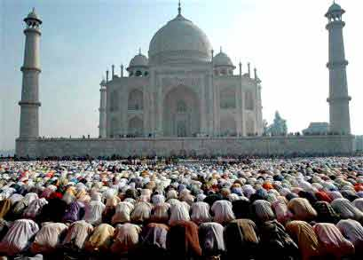
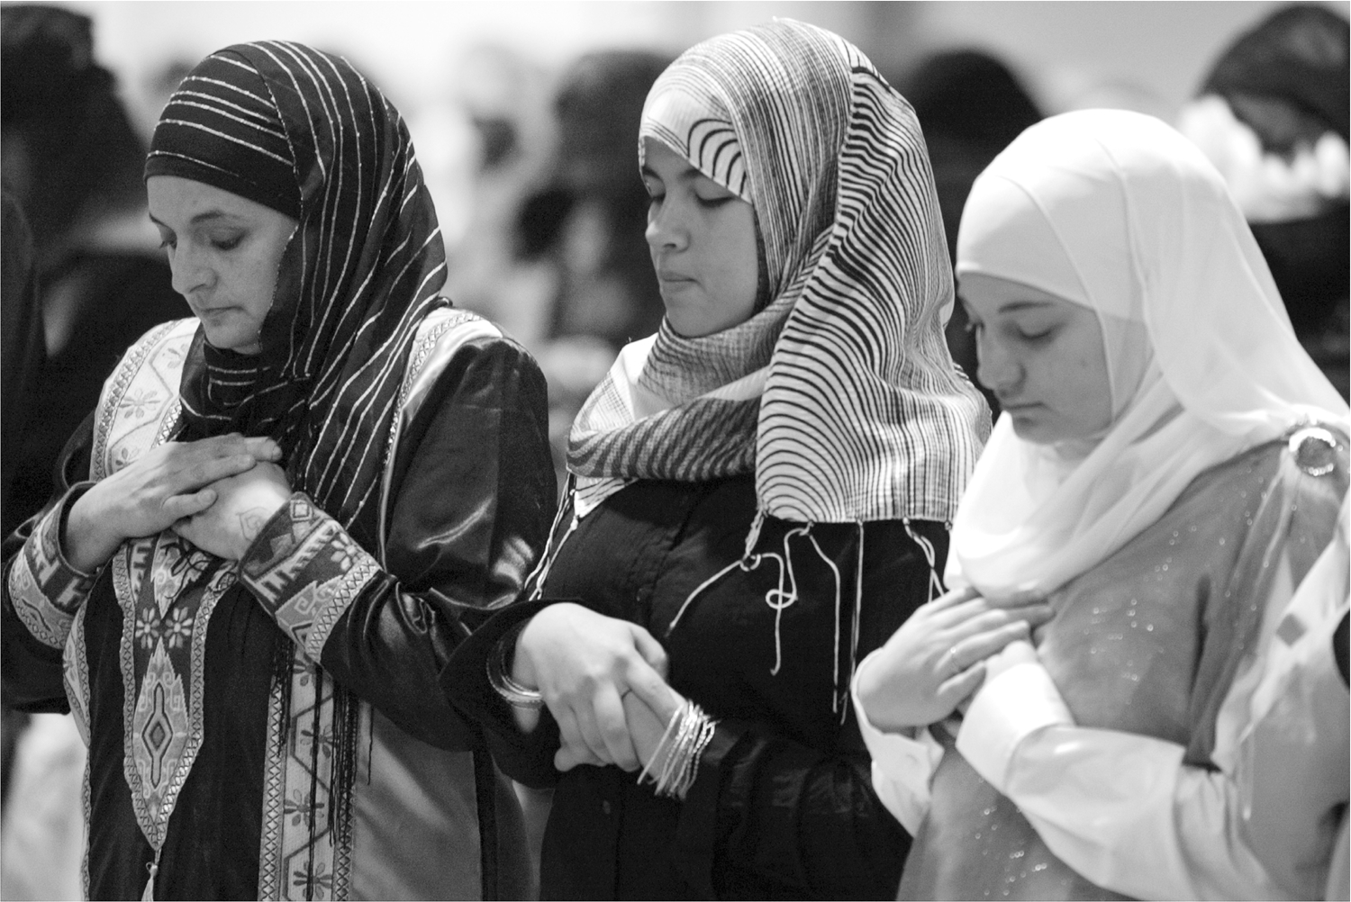
Islam (Muslim)
Qur’an: Prophet Mohammed
Ramadan
Mosque
Hijab/Burqa

Slide 21
Other religions
Mormonism (Mormon)
  Book of Mormon: Joseph Smith
Agnosticism (Agnostic)
  Maybe there is a God, but I don’t care
Atheism (Atheist)
  There is no God
  Belief in science and fact

Slide 22
Telling a Story About Your Family
Set the scene
  When I was younger…
  A lot time ago…
Introducing a sudden event
  All of a sudden, …
  Suddenly, …
Creating suspense
Sounding dramatic
Looking back
  It was the most (adjective) day of my life!
  I felt on top of the world.

Slide 23
Resources
Host Families in the USA:
http://china.international-experience.net
Culture differences between China and the USA:
http://www.china-nafsa.aief-usa.org/culture/differences.htm
Adoption Statistics:
http://adoption.state.gov/about_us/statistics.php

